Slide 2
Business Overview
Everyone will be muted during the presentation & unmuted at end of Presentation.
Save your questions until after the meeting.
Enjoy your time with us.

Slide 3
The largest independent financial services marketing company in North America with 130,000 licensed Representatives
Listed on the New York Stock Exchange (PRI)
In business since 1977
Over 5.5 million lives insured and approximately 2.6 million investment clients
As of December 31, 2020
Primerica representatives market term life insurance underwritten by National Benefit Life Insurance Company (Home Office: Long Island City, NY) in New York and Primerica Life Insurance Company (Executive Offices: Duluth, GA) in all other U.S. jurisdictions. In the U.S., securities are offered through PFS Investments Inc., 1 Primerica Parkway, Duluth, Georgia 30099-0001. PFS Investments Inc. is a member of FINRA and SIPC.

Slide 4
Recognition presented by Forbes and Statista. Insurance companies were identified through an independent survey of more than 16,000 U.S. consumers with at least one insurance policy. The survey considered customers’ overall recommendations, their general satisfaction and ratings in five specific areas. In the U.S., term life insurance is underwritten by Primerica Life Insurance Company, Executive Offices: Duluth, GA except New York, and National Benefit Life Insurance Company, Home Office: Long Island City, NY in New York State.
4

Slide 5
Recognition presented by Forbes and Statista. Insurance companies were identified through an independent survey of more than
16,000 U.S. consumers with at least one insurance policy. The survey considered customers' overall recommendations, their general
satisfaction and ratings in five specific areas. In the U.S., term life insurance is underwritten by Primerica Life Insurance Company,
Executive Offices: Duluth, GA except New York, and National Benefit Life Insurance Company, Home Office: Long Island City, NY in New York State.

Slide 6
Recognition presented by Forbes and Statista. Insurance companies were identified through an independent survey of more than
16,000 U.S. consumers with at least one insurance policy. The survey considered customers' overall recommendations, their general
satisfaction and ratings in five specific areas. In the U.S., term life insurance is underwritten by Primerica Life Insurance Company,
Executive Offices: Duluth, GA except New York, and National Benefit Life Insurance Company, Home Office: Long Island City, NY in New York State.

Slide 7
All of this without any national TV or radio advertising!

Slide 8
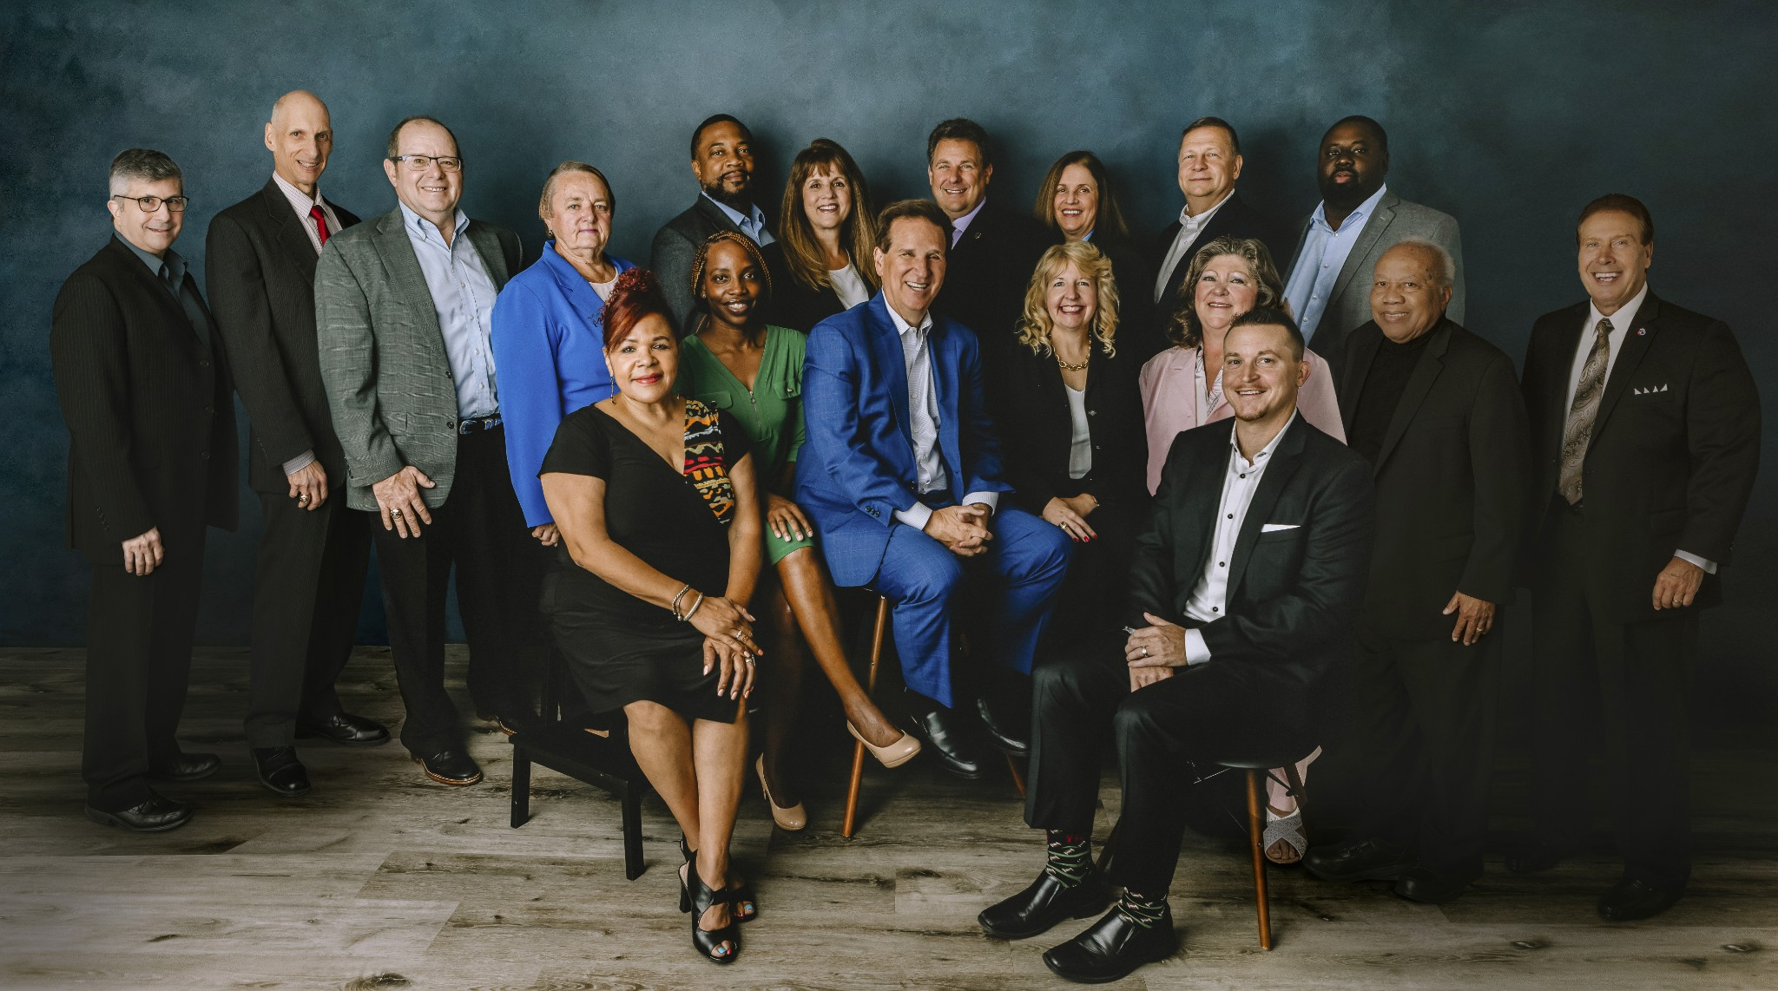
RVP TEAM

Slide 9
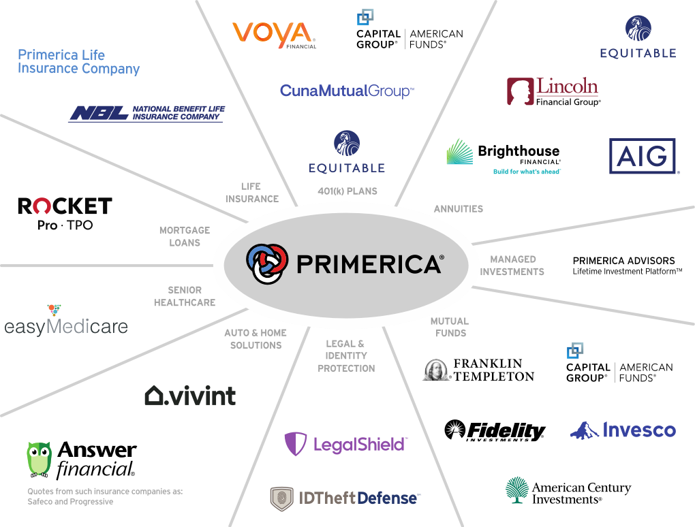
Not all products and services are available in all states, territories, or the District of Columbia. A representative's ability to offer products from the companies listed is subject to state and federal licensing and certification requirements. Please refer to the Important Endnotes for additional details about the contractual arrangements and company affiliations detailed above.

Slide 10
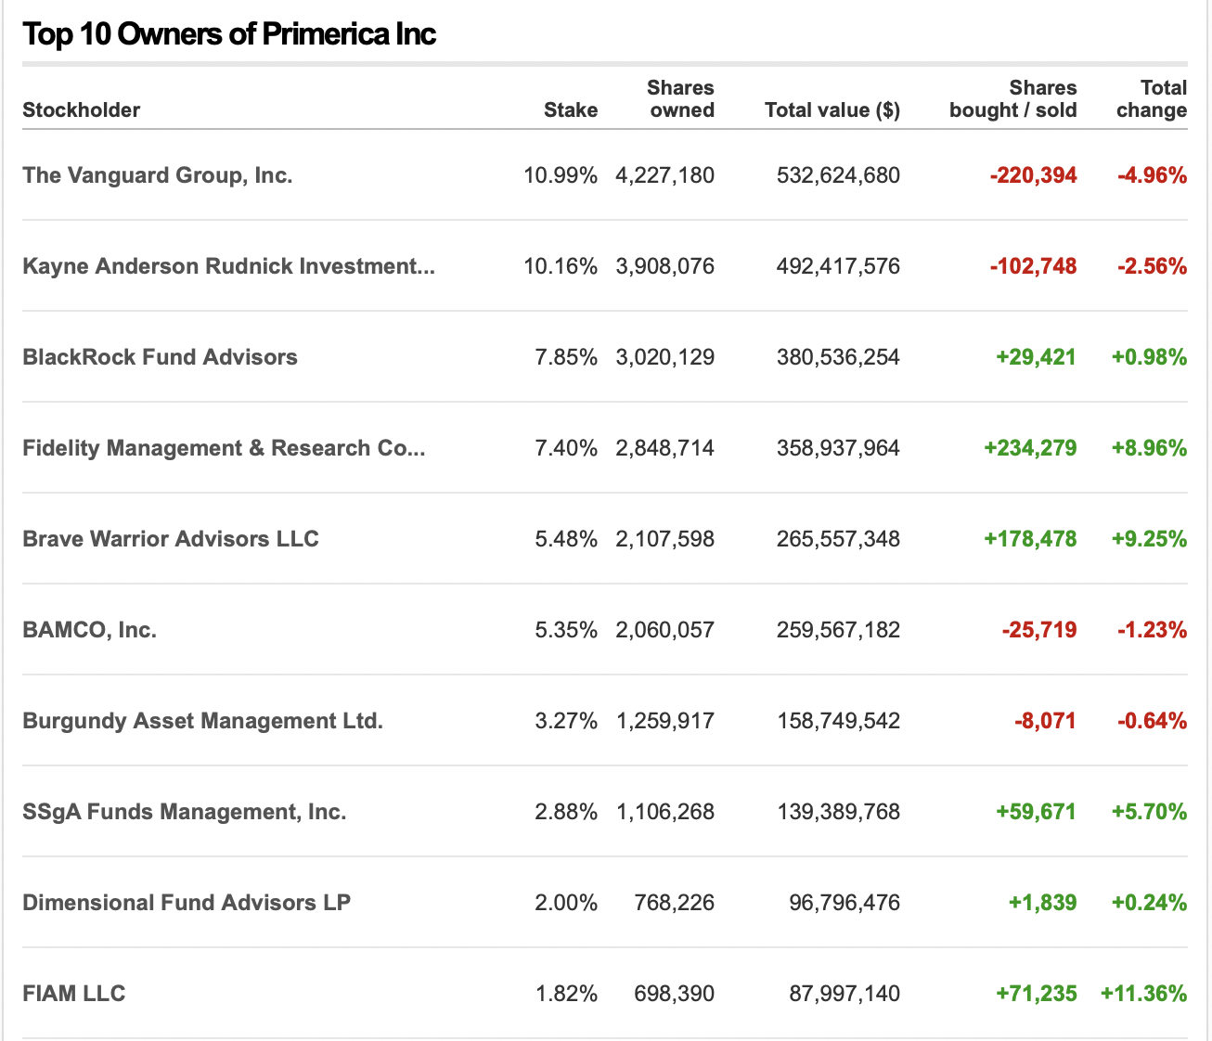
STOCKHOLDERS
OUR BIGGEST COMPETITORS ARE NOW OUR BIGGEST INVESTORS
IF YOU CAN’T BEAT THEM JOIN THEM!

Slide 12
FINANCIAL GAME PLAN
RENTING
WEALTH
ESTABLISHED
WEALTH
PRIMARY
$300,000
$300 x 12
MONTHS
$3,600
THEORY OF DECREASING RESPONSIBILTY
SPOUSE
COVERAGE
$3,600 x 30
$108,000
$300,000
YEARS
CHILDREN
COVERAGE
RETIREMENT TOTAL
$452,097
$10,000
HOW LIFE WORKS
INSTANT PROTECTION
COVERAGE
$100
IN THE EARLIER YEARS, PROTECTION IS A MUST
IN THE LATER YEARS, RETIREMENT INCOME IS A MUST
TODAY
35/32
RETIREMENT
65/62
AGE
AGE
$300
HOUSE MORTGAGE
CHILDREN GROWN
HIGH DEBT
LOWER DEBT
MONTHLY
INVESTMENT
YOUNG CHILDREN
MORTGAGE PAID
LOSS OF INCOME WOULD BE DEVASTATING
RETIREMENT INCOME IS NEEDED
YOU’RE NOW SELF INSURED
$200
IN THE EARLIER YEARS, YOU MAY NOT HAVE MONEY
IN THE LATER YEARS, YOU MAY NOT.
MUTUAL FUND

Slide 13
COMPENSATION
$300
$100
MONTHLY INVESTMENT
$200
INSURANCE
MUTUAL FUND
$100
x 12
=
$1,200
INSURANCE
MONTHS
$1,200
x 50%
=
$600
+
$3.50
YEARLY
ADVANCE
MONTHLY
RESIDUAL
INCOME
$600
x 3
=
$1,800
+
$10.50
PER CLIENT
CLIENTS
MONTHLY
$1,800
x 12
=
$21,600
+
$126
INSURANCE
MONTHS
MONTHLY

Slide 17
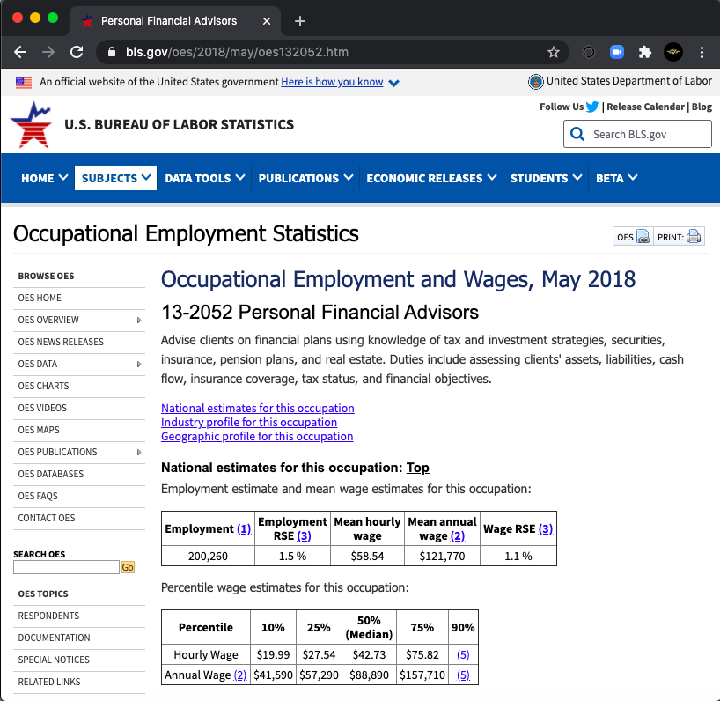
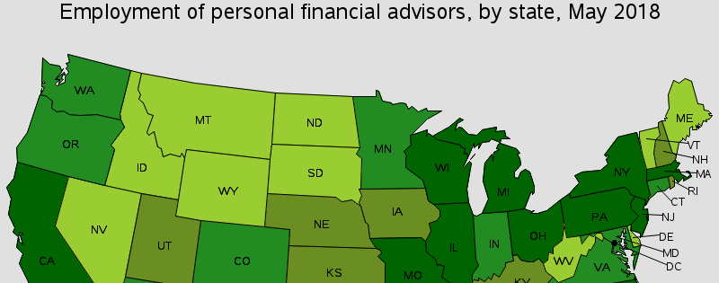
THE STAT’S
OCCUPATION
Real Estate
3 Million
Attorney’s
2 Million
Doctor’s
1 Million
Financial Advisor’s
300k
56
AVERAGE AGE
50% WILL BE RETIRING IN THE NEXT DECADE

Slide 18
WE TAKE THE UPFRONT COST & SPONSOR YOU
LIFE INSURANCE LICENSE
INVESTMENTS LICENSE
MORTGAGE LICENSE

Slide 19
Independent Business Application (IBA)
$99
The Ultimate Business Support System
$25
MONTH
Application Value Includes:
State Application
Exam Fee
Processing Fees
Appointment Fee
Fingerprint
Typical Cost to Becoming Fully Licensed Approximately $3000
Technology Support Package Value Includes:
Cell phone discount: up to 25%/yr.
Your own website and business reports: $50/mo.
Live and on-demand video training: $55/mo.
Total Value: $105+/month
Additional Potential Value Includes:
Exam Fee: $450
Exam Prep Course: $150 to $200
Securities License Total: Approximately $1,000*
Software $625/mo.**

Slide 20
BROKER COMPENSATION
110%
TOTAL PAYOUT
$1,320
OVERRIDE
$720
+
$3.50
INSURANCE
RESIDUAL INCOME
10
20
10
20
x
x
2
2
=
=
20
40
DON’T WORK
DON’T WORK
WORK
CLIENTS
CLIENTS
CLIENTS
WORK
CLIENTS
x
x
$720
$720
PER CLIENT
20
PER CLIENT
40
$28,800
$14,400
AGENTS
AGENTS
FOR THE MONTH
$600
+
FOR THE MONTH
$3.50
INSURANCE
RESIDUAL INCOME

Slide 21
3 Choices

Slide 22
Thank you for attending

